Slide 1
Operating Systems
Chapter 6c
Process Synchronization
Hammad Afzal
hammad.afzal@mcs.edu.pk
Department of Computer Software Engineering
National University of Sciences and Technology

Slide 2
Process Synchronization
Classic Problems of Synchronization
Monitors

Slide 3
Classical Problems of Synchronization
Classical problems used to test newly-proposed synchronization schemes
Bounded-Buffer Problem
Readers and Writers Problem
Dining-Philosophers Problem

Slide 4
Bounded-Buffer Problem
N buffers, each can hold one item
Constraints
The Producer cannot insert into a full buffer
The Consumer cannot take from an empty buffer
Updates to the buffer must be mutually exclusive
How to Solve
Semaphore mutex initialized to the value 1
Semaphore full initialized to the value 0
Semaphore empty initialized to the value N

Slide 5
Bounded Buffer Problem (Cont.)
The structure of the producer process
do { // produce an item in nextp
wait (empty);
wait (mutex);
// add the item to the buffer
signal (mutex);
signal (full);
} while (TRUE);

Slide 6
Bounded Buffer Problem (Cont.)
The structure of the consumer process
do {
wait (full);
wait (mutex);
// remove an item from buffer to nextc
signal (mutex);
signal (empty);
// consume the item in nextc
} while (TRUE);

Slide 7
Readers-Writers Problem
A data set is shared among a number of concurrent processes
Readers – only read the data set; they do not perform any updates
Writers – can both read and write
Problem –
Allow multiple readers to read at the same time
Only one single writer can access the shared data at the same time

Slide 8
Readers-Writers Problem
Several variations of how readers and writers are treated – all involve priorities
Shared Data
Data set
Semaphore mutex initialized to 1
Semaphore wrt initialized to 1
Integer readcount initialized to 0
Simplest Variation
No reader be kept waiting unless writer has already obtained permission to use shared object.

Slide 9
Readers-Writers Problem (Cont.)
The structure of a writer process
do {
wait (wrt) ;
// writing is performed
signal (wrt) ;
} while (TRUE);

Slide 10
Readers-Writers Problem (Cont.)
The structure of a reader process
do {
wait (mutex) ;
readcount ++ ;
if (readcount == 1)
wait (wrt) ;
signal (mutex)
// reading is performed
wait (mutex) ;
readcount - - ;
if (readcount == 0)
signal (wrt) ;
signal (mutex) ;
} while (TRUE);

Slide 11
Readers-Writers Problem Variations
First variation – no reader kept waiting unless writer has permission to use shared object
Second variation – once writer is ready, it performs write asap
Both may have starvation leading to even more variations
In first case, writers may starve
In second case, readers may starve
Problem is solved on some systems by kernel providing reader-writer locks

Slide 12

Dining-Philosophers Problem

Slide 13
Dining-Philosophers Problem
Philosophers spend their lives thinking and eating
Don’t interact with their neighbors, occasionally try to pick up 2 chopsticks (one at a time) to eat from bowl
Need both sticks to eat, then release both when done
In the case of 5 philosophers
Shared data
Bowl of rice (data set)
Semaphore chopstick [5] initialized to 1

Slide 14
Dining-Philosophers Problem Algorithm
The structure of Philosopher i:
do {
wait ( chopstick[i] );
wait ( chopStick[ (i + 1) % 5] );
// eat
signal ( chopstick[i] );
signal (chopstick[ (i + 1) % 5] );
// think
} while (TRUE);
What is the problem with this algorithm?

Slide 15
Dining-Philosophers Problem Algorithm
What is the problem with this algorithm?
Suppose all philosophers become hungry at same time and each of them picks up one stick.
Several possible remedies:
Allow at most four philosophers to be sitting simultaneously at the table.
Allow to pick up both together (must be picked up in critical section)
Use an asymmetric solution, an odd professor picks up first her left chopstick and then her right chop stick.

Slide 16
Problems with Semaphores
Incorrect use of semaphore operations:
signal (mutex) …. wait (mutex)
wait (mutex) … wait (mutex)
Omitting of wait (mutex) or signal (mutex) (or both)
Deadlock and starvation

Slide 17
Monitors
The monitor is a programming-language construct that provides equivalent functionality to that of semaphores and that is easier to control.
Implemented in a number of programming languages, including
Concurrent Pascal, Pascal-Plus,
Modula-2, Modula-3, and Java.

Slide 18
Chief characteristics
Local data variables are accessible only by the monitor
Process enters monitor by invoking one of its procedures
Only one process may be executing in the monitor at a time
Notes:
The chief characteristics of a monitor are the following:
1. The local data variables are accessible only by the monitor’s procedures and not by any external procedure.
2. A process enters the monitor by invoking one of its procedures.
3. Only one process may be executing in the monitor at a time; any other processes that have invoked the monitor are blocked, waiting for the monitor to become available.

Slide 19
Synchronization
Synchronisation achieved by condition variables within a monitor
only accessible by the monitor.
Monitor Functions:
Cwait(c): Suspend execution of the calling process on condition c
Csignal(c) Resume execution of some process blocked after a cwait on the same condition
Notes:
A monitor supports synchronization by the use of condition variables that are
contained within the monitor and accessible only within the monitor.
cwait(c): Suspend execution of the calling process on condition c.
The monitor is now available for use by another process.
csignal(c): Resume execution of some process blocked after a cwait on the same condition.
If there are several such processes, choose one of them; if there is no such process, do nothing.

Slide 20
Monitors
Only one process may be active within the monitor at a time
But not powerful enough to model some synchronization schemes
monitor monitor-name
{
// shared variable declarations
procedure P1 (…) { …. }
procedure Pn (…) {……}
Initialization code (…) { … }
}
}

Slide 21
Condition Variables
condition x, y;
Two operations on a condition variable:
x.wait () – a process that invokes the operation is suspended until x.signal ()
x.signal () – resumes one of processes (if any) that invoked x.wait ()
If no x.wait () on the variable, then it has no effect on the variable

Slide 22
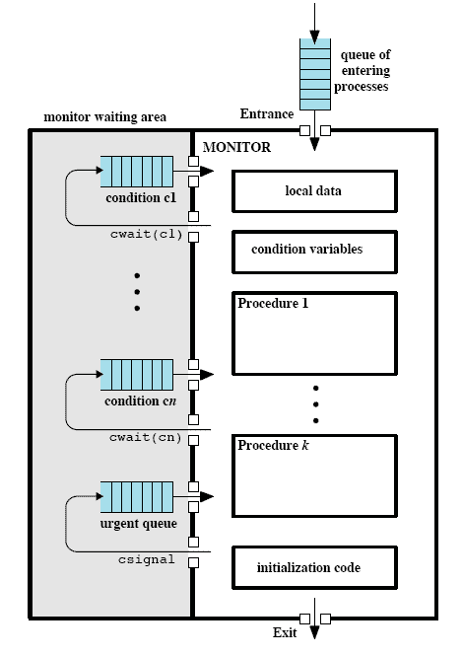
Structure of a Monitor
Notes:
Although a process can enter the monitor by invoking any of its procedures, we can think of the monitor as having a single entry point that is guarded so that only one process may be in the monitor at a time.
Other processes that attempt to enter the monitor join a queue of processes blocked waiting for monitor availability.
Once a process is in the monitor, it may temporarily block itself on condition x by issuing cwait(x);
it is then placed in a queue of processes waiting to re-enter the monitor when the condition changes, and resume execution at the point in its program following the cwait(x) call.
If a process that is executing in the monitor detects a change in the condition variable x, it issues csignal(x),
which alerts the corresponding condition queue that the condition has changed.

Slide 23
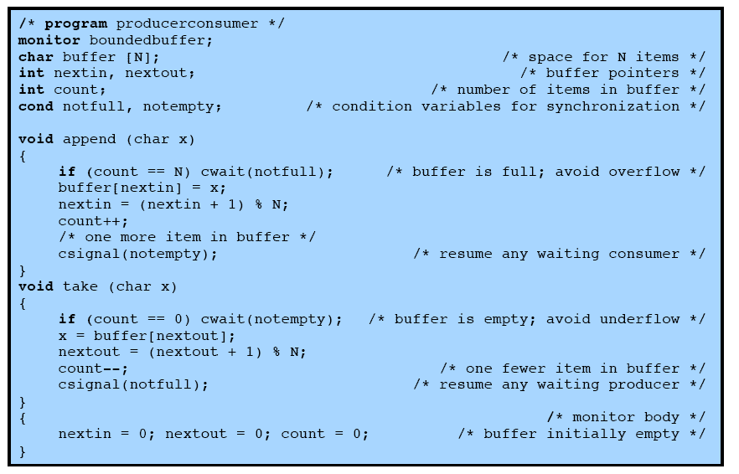
Bounded Buffer Solution Using Monitor
Notes:
Returning to the bounded-buffer producer/consumer problem – this is a solution using a monitor.
The module, boundedbuffer, controls the buffer used to store and retrieve characters.
The monitor includes two condition variables (declared with the construct cond):
notfull is true when there is room to add at least one character to the buffer,
and notempty is true when there is at least one character in the buffer.
This example points out the division of responsibility with monitors compared to semaphores.
In the case of monitors, the monitor construct itself enforces mutual exclusion:
It is not possible for both a producer and a consumer simultaneously to access the buffer.
However, the programmer must place the appropriate cwait and csignal primitives inside the monitor to prevent processes from depositing items in a full buffer or removing them from an empty one.
In the case of semaphores, both mutual exclusion and synchronization are the responsibility of the programmer.

Slide 24
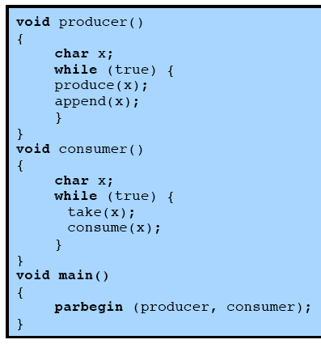
Solution Using Monitor
Notes:
Note here that a process exits the monitor immediately after executing the csignal function.
One language, ConcurrentPascal, insists that nothing follows a csignal call

Slide 25
Condition Variables Choices
If process P invokes x.signal (), with Q in x.wait () state, what should happen next?
If Q is resumed, then P must wait
Options include
Signal and wait – P waits until Q leaves monitor or waits for another condition
Signal and continue – Q waits until P leaves the monitor or waits for another condition
Both have pros and cons – language implementer can decide

